Slide 1
Event Management Website
by Dimitri Sabra

Slide 2
Objective: Event Management Website
1
User-Friendly Interface
The website is designed to offer a seamless and intuitive user experience, ensuring quick navigation and accessibility to important information.
2
Interactive Event Registration
It allows users to easily register for events through a simple and efficient registration process, enhancing user engagement and participation.
3
Engaging Visual Content
The website incorporates captivating images to provide a visually enriching experience, enticing visitors to explore upcoming events.

Slide 3
Code for Event Management Website
.navigation-links a {
margin-right: 10px;
text-decoration: none;
color: #fff;
}
form { text-align: center;
margin-bottom: 20px;
}
.input {
width: 100%;
padding: 10px;
margin-bottom: 10px;
box-sizing: border-box;
}
.MenuBarHorizontal li {
display: inline-block;
}
textarea {
width: 100%;
height: 100px;
padding: 10px;
margin-bottom: 10px;
box-sizing: border-box;
}
.event-description {
margin-bottom: 20px;
}
.event-photos {
display: flex;
justify-content: center;
align-items: flex-start;
flex-wrap: wrap;
margin-bottom: 20px;
}
.photo-description {
text-align: center;
margin-bottom: 10px;
flex-basis: 50%;
box-sizing: border-box;
padding: 10px;
}
.event-photos img {
width: 100%;
height: 150px;
margin-bottom: 10px;
}
.top-space {
margin-top: 20px;
}
.italic-text {
font-style: italic;
text-align: center;
}
.button {
background-color: #000;
color: #fff;
padding: 10px 20px;
border: none;
border-radius: 5px;
font-size: 16px;
cursor: pointer;
}
</style>
</head>
<body>
<div class="container">
<div class="navigation">
<div class="navigation-left">
Event Planner
</div>
<div class="navigation-links" id="sprymenu">
<ul class="MenuBarHorizontal">
<li><a class="MenuBarItemSubmenu" href="#">Home</a></li>
<li><a class="MenuBarItemSubmenu" href="#">Events</a></li>
<li><a class="MenuBarItemSubmenu" href="#">About</a></li>
<li><a class="MenuBarItemSubmenu" href="#">Contact</a></li>
</ul>
</div>
</div>
<h1 class="top-space">Event Management</h1>
<p class="italic-text">Join us for an unforgettable experience!</p>
<form action="submit" method="get">
<input type="text" class="input" name="firstName" placeholder="First Name" required><br>
<input type="text" class="input" name="lastName" placeholder="Last Name" required><br>
<input type="email" class="input" name="email" placeholder="Email Address" required><br>
<textarea name="eventDescription" placeholder="Event Description " required></textarea><br>
<button type="submit" class="button">Register</button>
</form>
<br>
<div class="event-description">
<h2>Event Description</h2>
<p>Welcome to the most anticipated event of the year! Join us for an unforgettable experience filled with excitement, entertainment, and inspiration. Our event brings together renowned speakers, captivating performances, and interactive workshops to ignite your passion and leave you with lasting memories. Don't miss out on this extraordinary opportunity to connect with like-minded individuals and be part of a truly remarkable event!</p>
</div>
<div class="event-photos">
<div class="photo-description">
<img src="Event/photo1.jpg">
<p>Captivating Performances: Witness breathtaking performances that will leave you spellbound and amazed. Get ready to be dazzled by our talented artists and experience the magic firsthand.</p>
</div>
<div class="photo-description">
<img src="Event/photo2.jpg">
<p>Inspiring Keynote Speakers: Gain valuable insights and wisdom from our esteemed keynote speakers. They will share their experiences and motivate youto reach new heights of success.</p>
</div>
<div class="photo-description">
<img src="Event/photo3.jpg">
<p>Engaging Workshops: Dive into interactive workshops designed to enhance your skills and expand your horizons. Learn from industry professionals and gain practical knowledge to excel in your field.</p>
</div>
<div class="photo-description">
<img src="Event/photo4.jpg">
<p>New Addition: Experience something extraordinary with our latest addition, Photo 4. It promises to deliver an unforgettable experience that will leave you inspired.</p>
</div>
</div>
</div>
</body>
</html>
<!DOCTYPE html>
<html>
<head>
<title>Event Management</title>
<style>
body {
font-family: Comic sans-serif;
margin: 0;
padding: 0;
background: linear-gradient(135deg, #F8F8F8, #ECECEC);
}
.container {
max-width: 800px;
margin: 0 auto;
padding: 20px;
}
h1.top-space {
margin-top: 40px;
}
h1 {
text-align: center;
margin-bottom: 20px;
margin-top: 90px;
}
.navigation {
display: flex;
justify-content: space-between;
align-items: center;
background-color: #333;
color: #fff;
padding: 10px;
}
.navigation-left {
font-weight: bold;
}

Slide 4
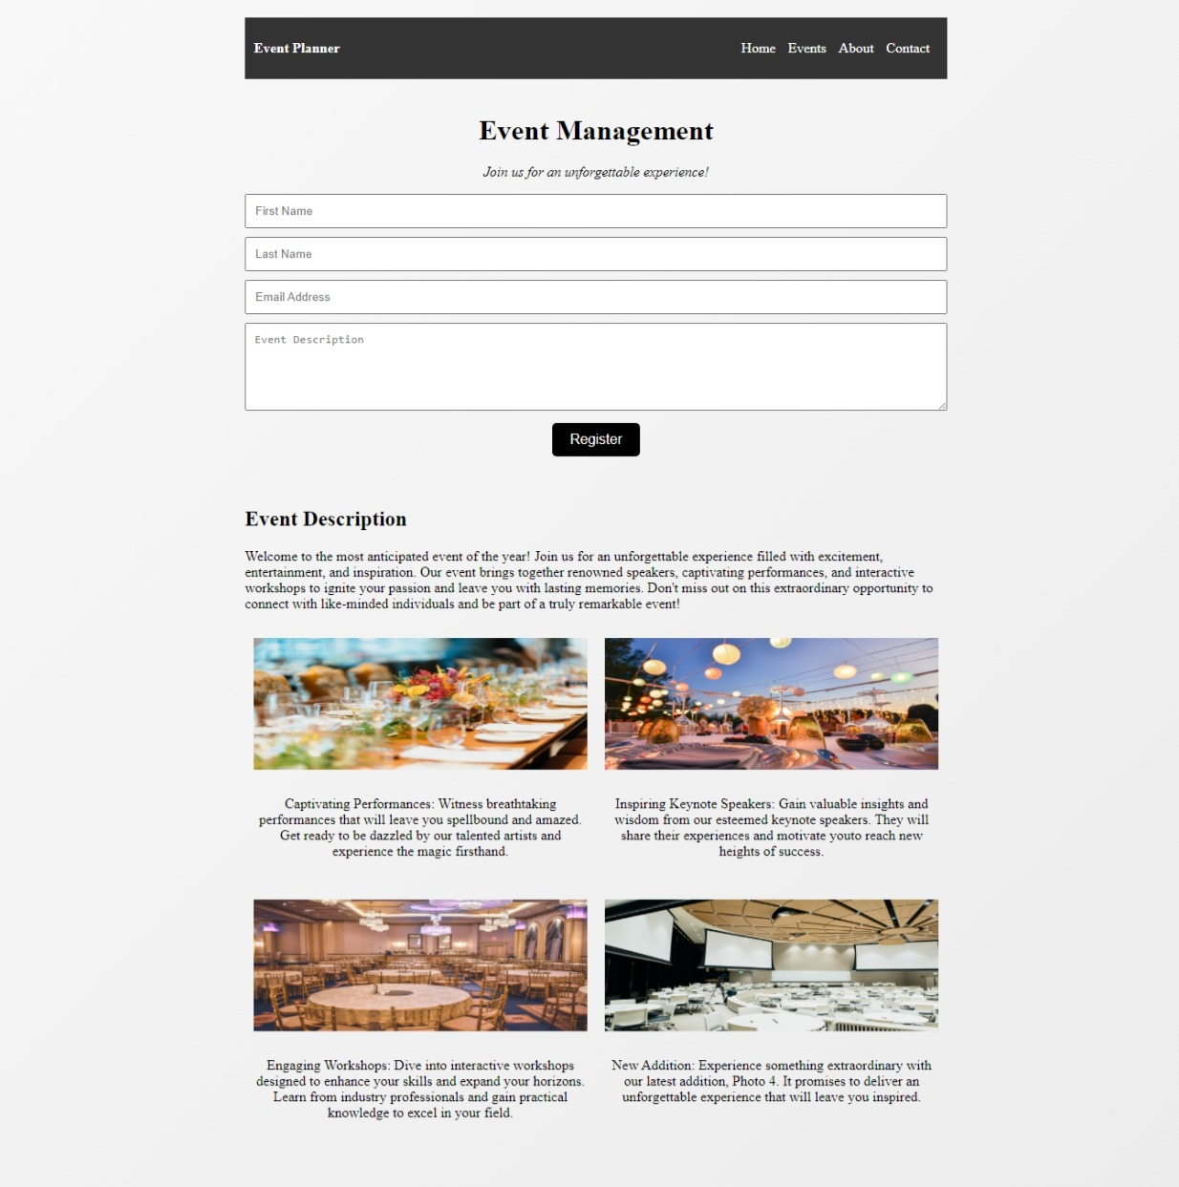
Result and Explanation
Functionality
This HTML code is for an event management webpage with a modern design. It includes a registration form and highlights captivating performances and engaging workshops. The webpage aims to attract attendees to the event.

Slide 5
Conclusion
1
Seamless User Experience
2
Innovative Design Approach
The Event Management Website epitomizes a seamless and engaging user experience, setting a benchmark for modern web interfaces.
By integrating rich multimedia and interactive functionalities, the website showcases an innovative approach to event management platforms.

